Slide 1
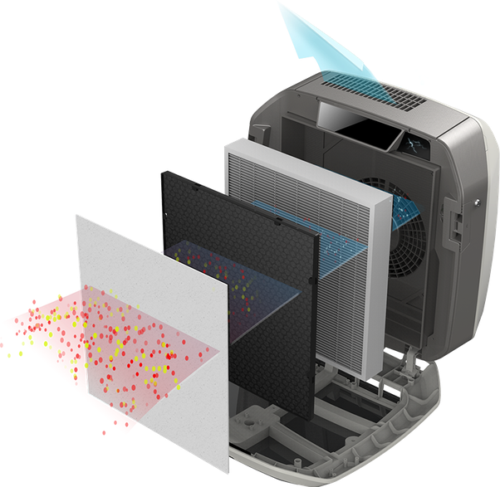
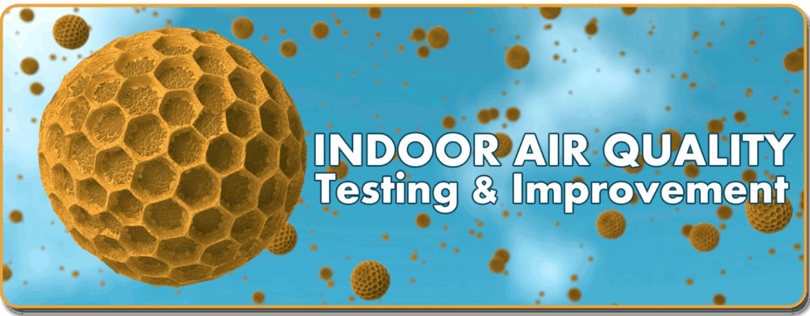
Market fit Research for Air Purifier development
Power BI Desktop

Slide 2
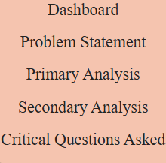
Problem Statement
Power BI Desktop
"Air Pure Innovations" is a startup born out of the air quality crisis in India, with 14 cities ranking among the world’s top 20 most polluted urban centers. The company is in the early stages of product
development and is unsure whether there is a strong, sustained demand for its air purifier product. Before committing to production and R&D, they need to answer critical questions:
What pollutants or particles should their air purifier target?
What are the most essential features that should be incorporated into the air purifier?
Which cities have the highest demand for air purifiers, and what is the market size in these regions?
How can R&D be aligned with localized pollution patterns?

Slide 3
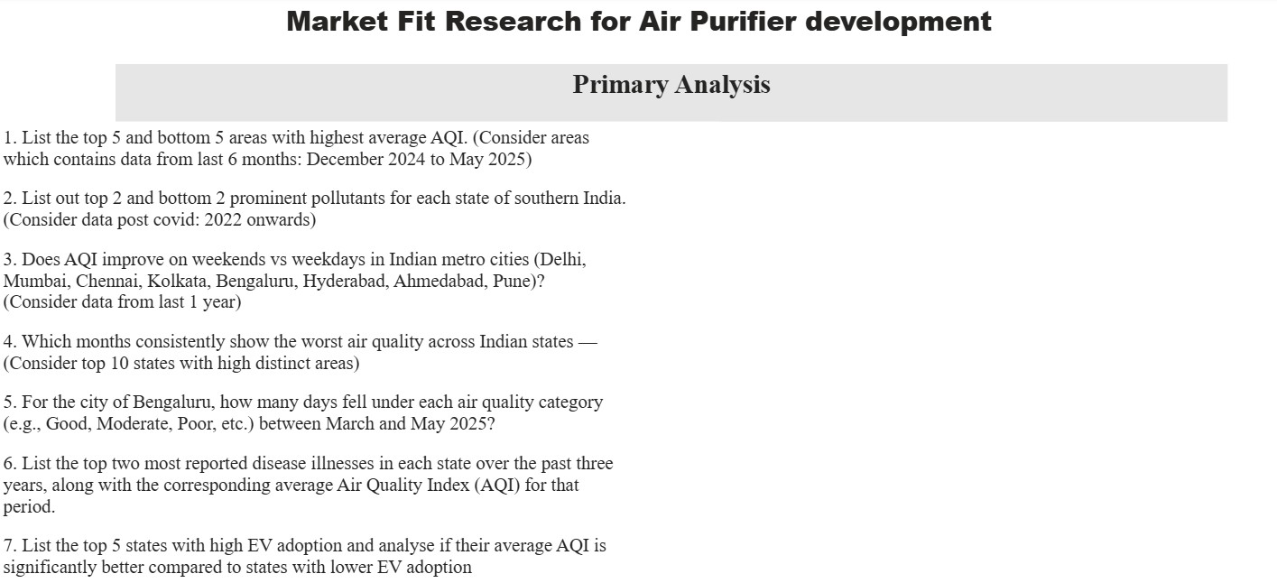
Power BI Desktop

Slide 4
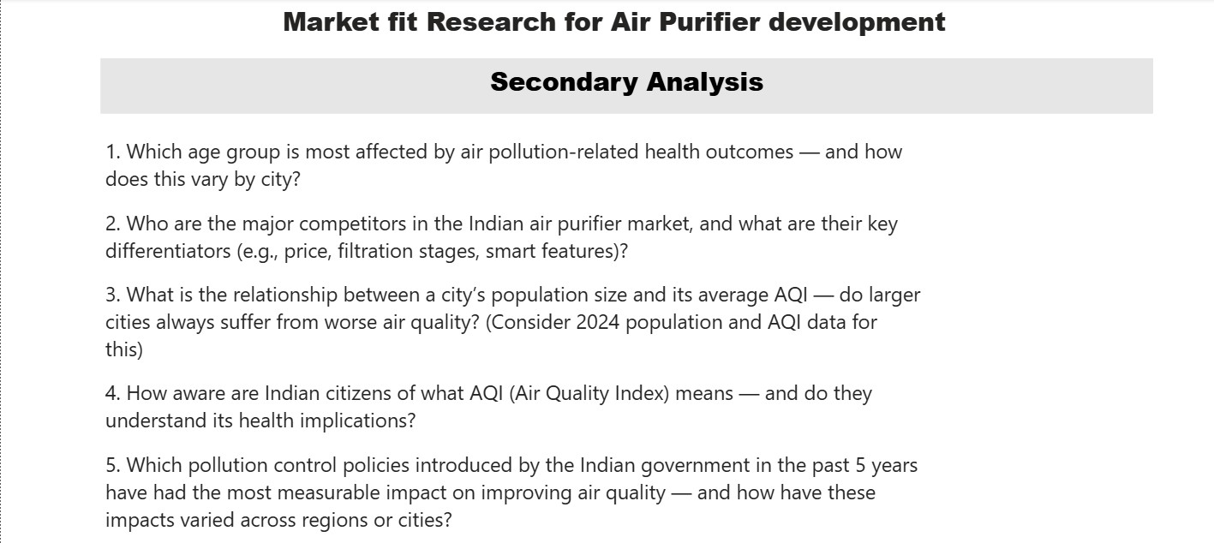
Power BI Desktop

Slide 5
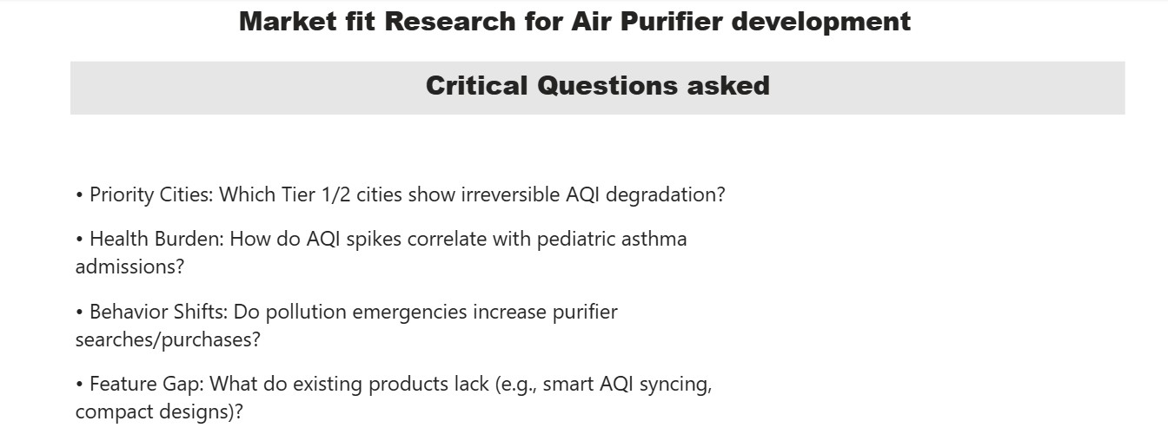
Power BI Desktop

Slide 6
1. List the top 5 and bottom 5 areas with highest average AQI.
Power BI Desktop
(Consider areas which contains data from last 6 months: December 2024 to May 2025)
Top 5 area with highest avg aqi
Bottom 5 area with highest avg aqi
284
45
44
43
43
239
234
226
33
204
Average AQI
Average AQI
Chamarajanagar
Vijayapura
Madikeri
Palkalaiperur
Tirunelveli
Byrnihat
Delhi
Hajipur
Area
Bahadurgarh
Gurugram
Area

Slide 7
2. List out top 2 and bottom 2 prominent pollutants for each state of southern India.
Power BI Desktop
(Consider data post covid: 2022 onwards)
state prominent_pollutants Category Average of aqi_value
prominent_pollutants CO PM10 PM10,PM2.5,NO2 PM2.5,PM10 SO2
bottom_2 top_2
Karnataka | CO | bottom_2 | 8.00
Karnataka | PM10 | bottom_2 | 8.00
Karnataka | PM10 | top_2 | 480.00
Tamil Nadu | PM10 | bottom_2 | 8.00
Tamil Nadu | PM10 | top_2 | 390.00
Tamil Nadu | SO2 | bottom_2 | 8.00
Telangana | PM10 | bottom_2 | 37.00
Telangana | PM10,PM2.5,NO2 | bottom_2 | 38.00
Telangana | PM2.5,PM10 | top_2 | 165.50
Karnataka
Tamil Nadu Telangana
state
Total
168.15
Karnataka
Tamil Nadu Telangana
state
0
500
Average of aqi_value
0
500
Average of aqi_value

Slide 8
Pollutant Particles to target
Power BI Desktop
Prominent pollutants in India
Prominent pollutants in India
prominent_pollutants
PM10
PM10 PM2.5
O3 PM2.5,PM10
CO PM10,O3
SO2 NO2 PM10,CO PM2.5,O3 PM10,NO2
O3,PM2.5,PM10 PM2.5,PM10,CO
PM10,SO2
CO,O3 PM10,O3,CO PM2.5,NO2
0K
3K (1.13%)(0.05%)
4K (1.66%)
13K (5.46%)
13K (5.6%)
PM2.5 O3
PM2.5,PM10
CO PM10,O3 SO2 NO2 PM10,CO
PM2.5,O3
PM10,NO2 O3,PM2.5,PM10 PM2.5,PM10,CO PM10,SO2 CO,O3
111K (47.1%)
Type of Particle
16K (6.87%)
60K (25.31%)
0K
50K
Number of Particles
100K

Slide 9
3. Does AQI improve on weekends vs weekdays in Indian metro cities (Delhi,
Power BI Desktop
Mumbai, Chennai, Kolkata, Bengaluru, Hyderabad, Ahmedabad, Pune)? (Consider data from last 1 year)
area
V
Week type
V
Weekday
Weekend
All
V
Average of aqi_value by Week type and area
Ahmedabad Bengaluru Chennai Delhi Hyderabad Kolkata Mumbai Pune
area
area

Weekday Weekend Total
Ahmedabad | 113.14 | 112.21 | 113.60 74.89 74.01 206.42 81.01 102.03
Bengaluru | 75.01 | 72.53
Chennai | 74.07 | 72.90
Delhi | 204.72 | 206.33
Hyderabad | 80.36 | 80.80
Kolkata | 101.46 | 103.34
Total | 108.14 | 108.00 | 108.68
200
150
Aqi value
100
50
0
Weekday
Weekend
Week type

Slide 10

4. Which months consistently show the worst air quality across Indian states —
Power BI Desktop
(Consider top 10 states with high distinct areas)
Worst AQI month and States
Months with Worst aqi
Month name Average of avg_aqi state
V
Worst months
100%
Top 10 States with highest distinct areas
December
251.81
Bihar Yes
245.57 Bihar Yes
158.18
January
November
November
239.46 Haryana Yes
229.58 Bihar Yes
January
151.14
state
V
November
December
148.00
Uttar Pradesh
November
200.61 Uttar Pradesh Yes
193.61 Odisha Yes
122.64
January
February
Tamil Nadu
November
193.22 Rajasthan Yes
188.38 Bihar Yes
April
113.36
Rajasthan
February
107.43
Odisha
185.77 Haryana Yes
182.05 Haryana Yes
March
Maharashtra
December
May
106.62
Madhya Pradesh
January
December
176.34 Rajasthan Yes
167.74 Odisha Yes
October
105.03
Karnataka
December
June
90.74
Haryana
December
166.22 Uttar Pradesh Yes
165.44 Rajasthan Yes
164.54 Madhya Pradesh Yes
161.41 Bihar Yes
160.45 Uttar Pradesh Yes
65.50
Bihar
January
September
August
64.47
Andhra Pradesh
November
April
July
61.65
January
Total
107.90
39%

Slide 11
6. List the top two most reported disease illnesses in each state
Power BI Desktop
over the past three
years, along with the corresponding average Air Quality Index (AQI) for that
period.
Top two most reported disease illnesses in each state over the past three years, along with the corresponding average Air Quality Index (AQI) for that period
state disease_illness_name Average of aqi_value

5. For the city of Bengaluru, how many days fell under each air quality category
(e.g., Good, Moderate, Poor, etc.) between
March and May 2025?
Andaman and Nicobar Islands | Chickenpox | 90.34
Andaman and Nicobar Islands | Fever with Rash | 90.34
Andhra Pradesh | Scrub Typhus | 96.56
Andhra Pradesh | Typhoid | 96.56
Arunachal Pradesh | Suspected Mushroom Poisoning | 96.68
Arunachal Pradesh | Typhoid | 96.68
Assam | Typhoid | 103.51
Bihar | Typhoid | 97.91
Chhattisgarh | Typhoid | 95.99
Dadra and Nagar Haveli | Fever | 88.04
Dadra and Nagar Haveli | Fever of Unknown andigin (PUO) | 88.04
Dadra and Nagar Haveli and Daman and Diu | Food Poisoning | 108.65
Dadra and Nagar Haveli and Daman and Diu | Mumps | 108.65
Delhi | Dengue | 102.36
Delhi | Measles | 102.36
Goa | Kyasanur Fandest Disease | 98.68
Goa | Scrub Typhus | 98.68
Bengaluru data between March and May 2025
air_quality_status Sum of Days
Moderate 13
Satisfactory 48
Total 61
Total
111.13

Slide 12
Power BI Desktop
Top two most reported disease illnesses in each state over the past three years, along with the corresponding average Air Quality Index (AQI) for that period
state disease_illness_name Average of aqi_value

Andaman and Nicobar Islands | Chickenpox | 90.34
Andaman and Nicobar Islands | Fever with Rash | 90.34
Andhra Pradesh | Scrub Typhus | 96.56
Andhra Pradesh | Typhoid | 96.56
Arunachal Pradesh | Suspected Mushroom Poisoning | 96.68
Arunachal Pradesh | Typhoid | 96.68
Assam | Typhoid | 103.51
Bihar | Typhoid | 97.91
Chhattisgarh | Typhoid | 95.99
Dadra and Nagar Haveli | Fever | 88.04
Dadra and Nagar Haveli | Fever of Unknown andigin (PUO) | 88.04
Dadra and Nagar Haveli and Daman and Diu | Food Poisoning | 108.65
Dadra and Nagar Haveli and Daman and Diu | Mumps | 108.65
Delhi | Dengue | 102.36
Delhi | Measles | 102.36
Goa | Kyasanur Fandest Disease | 98.68
Goa | Scrub Typhus | 98.68
Total
111.13

Slide 13
7. List the top 5 states with high EV adoption and analyze if their average AQI is
Power BI Desktop
significantly better compared to states with lower EV adoption.
Top 5 States with high EV adoption table
Top 5 states with high EV adoption bar chart
Total EVs adopted Average of aqi_value
40K
state
Total EVs adopted Avg AQI Population
V
Uttar Pradesh | 38984 | 126.42 | 4526863
Karnataka | 35717 | 62.67 | 3659615
Maharashtra | 20755 | 103.64 | 4970780
Delhi | 20530 | 206.42 | 2584182
Kerala | 17605 | 68.07 | 2309511
Bihar | 17251 | 157.16 | 2435691
Tamil Nadu | 13029 | 67.76 | 3022227
Gujarat | 12911 | 110.63 | 3416733
Assam | 11891 | 114.12 | 2005415
Andhra Pradesh | 10083 | 77.51 | 2413707
Madhya Pradesh | 8738 | 108.72 | 1761225
Rajasthan | 8082 | 127.99 | 2086122
Haryana | 7735 | 140.85 | 1714946
Chhattisgarh | 7613 | 78.99 | 1581966
Odisha | 5952 | 124.88 | 1695372
West Bengal | 5087 | 114.19 | 3246546
30K
200
Total EVs adopted
Average of aqi_value
20K
100
10K
0K
Uttar Pradesh
Karnataka Maharashtra
Delhi Kerala Bihar
Tamil Nadu
Gujarat Assam
Andhra Pradesh Madhya Pradesh
Rajasthan Haryana
Chhattisgarh
Odisha West Bengal Jharkhand
Punjab Jammu and Kashmir
Goa Uttarakhand Chandigarh
0
Total
258525
111.13
85248778

Slide 14
1. Which age group is most affected by air pollution- related health outcomes — and how
does this vary by city?
Power BI Desktop
 | City | Most Affected Age Group | Major Health Outcomes | Key Reasons
 |  |  |  | 
 | Bengaluru | Adults (25–50) | Fatigue, respiratory irritation | Commuting exposure, tech workforce lifestyle
 | Delhi | Children (<14) & Elderly (>60) | Pediatric hospitalizations, elderly COPD & cardiac deaths | Highest PM2.5 levels, industrial + vehicular emissions
 | Kanpur | Children & Adults (15–45) | High under-5 mortality, asthma in working adults | Industrial emissions, biomass burning, poor circulation
 | Kolkata | Elderly (60+) | Stroke, cardiac mortality | Old vehicles, construction dust, high humidity
 | Lucknow | Children (<14) | Respiratory issues in children | Stagnant winter air, open waste burning
 | Chennai | Children (<14) | Allergic rhinitis, sinusitis, low birth weight | Thermal power, seasonal AQI spikes
 | Mumbai | Adults (30–55) | Heart disease, asthma | Traffic fumes, dense urban population

Slide 15
2. Who are the major competitors in the Indian air purifier market, and what
Power BI Desktop
are their key differentiators (e.g., price, filtration stages, smart features)?
Brand
Philips
Filtration Technology
HEPA + VitaShield
Key Differentiators
VitaShield, trusted brand
Smart Features
App Control, Child Lock
Price Range (INR)
V
₹9,000–₹25,000+
Coway HEPA + Multi-stage Long filter life, Korean tech Low Noise, Auto Mode ₹9,000–₹25,000 Honeywell HEPA + Carbon Value-for-money, reliable Auto Mode, No App Control ₹8,000–₹20,000 Kent HEPA + UV + Ionizer Budget ionizer combo Basic Only ₹8,000–₹20,000 Mi (Xiaomi) HEPA + Carbon + App Control Smart features, affordable App Control, Real-time AQI ₹7,000–₹15,000 Livpure HEPA + Carbon Entry-level, budget focused Basic ₹6,000–₹12,000
Dyson HEPA + Activated Carbon + Sensors Premium design, high-end sensors App Control, AQI Display, Auto Mode ₹35,000–₹60,000+ Blueair HEPASilent + Particle Filter Silent & stylish, premium build App + AQI, Silent Operation ₹18,000–₹45,000 Samsung / LG Multi-stage HEPA + Smart Sensors Smart home integration App Control, Voice Assistant ₹15,000–₹30,000 Sharp HEPA + Plasmacluster Ion Plasmacluster Ion tech, Japanese build Basic, Energy Efficient ₹12,000–₹28,000

Slide 16




3. What is the relationship between a city’s population size and its average AQI — do larger
Power BI Desktop
cities always suffer from worse air quality? (Consider 2024 population and AQI data for this)
Population size and average AQI by state
Average of aqi_value Population size

Population size and Average AQI value by state
state
Population
Average AQI value
 | Nagaland | 80.46 | 82108
 | Manipur | 100.93 | 131938
 | Tripura | 126.70 | 316234
 | Sikkim | 53.69 | 352627
 | Arunachal Pradesh | 54.49 | 368633
 | Meghalaya | 62.73 | 368700
 | Mizoram | 47.25 | 396244
 | Chandigarh | 141.56 | 414781
 | Jammu and Kashmir | 69.50 | 446124
 | Puducherry | 56.51 | 477480
 | Andaman and Nicobar Islands | 57.71 | 707064
 | Uttarakhand | 87.90 | 893142
 | Himachal Pradesh | 160.26 | 932841
 | Jharkhand | 164.94 | 1060804
 | Telangana | 81.01 | 1308093
 | Chhattisgarh | 78.99 | 1581966
 | Total | 111.13 | 85248778
5M
200
Average AQI value
Population
0M
Maharashtra
Uttar Pradesh Karnataka Gujarat West Bengal Tamil Nadu
Delhi Bihar
Andhra Pradesh
Kerala Rajasthan Punjab Assam
Madhya Pradesh
Haryana Odisha
Chhattisgarh Telangana Jharkhand
Himachal Pradesh
Uttarakhand Andaman and N…
Puducherry Jammu and Kas…
Chandigarh Mizoram Meghalaya
0
state

Slide 17
4. How aware are Indian citizens of what AQI (Air Quality Index) means —
Power BI Desktop
and do they understand its health implications?
Data about Awareness about AQI among Indians (Perception Study on Air Quality in 17 Cities BY CMSR)
Demographic Category | Sum of Aware & Understand AQI (%) V | Sum of Aware but Don’t Understand (%) | Sum of Not Aware & Don’t Understand (%)
Govt. Employees | 44.80 | 17.80 | 37.40
18–25 | 38.50 | 21.70 | 39.80
46–60 | 37.90 | 16.90 | 45.20
Private Sector | 36.80 | 23.10 | 40.00
Students | 36.50 | 17.00 | 46.40
Men | 35.80 | 17.20 | 47.10
Below 18 | 35.10 | 14.30 | 50.60
Overall Respondents | 35.00 | 19.10 | 45.90
Women | 34.00 | 21.60 | 44.50
26–35 | 33.40 | 21.80 | 44.80
36–45 | 32.80 | 21.40 | 45.70
60+ | 32.70 | 10.70 | 56.50
Homemakers | 29.30 | 23.60 | 47.20
Total | 462.60 | 246.20 | 591.10

Slide 18
Priority Cities: Which Tier 1/2 cities show irreversible AQI degradation?
Power BI Desktop
Cities with nearly irreversible AQI degradation
City
Tier
AQI 2020 AQI 2025 Primary Pollutants
V
Kanpur | Tier 2 | 345 | 340 | Industrial, PM2.5
Patna | Tier 2 | 330 | 325 | Brick kilns, PM2.5
Ghaziabad | Tier 2 | 325 | 320 | PM2.5, PM10
Delhi NCR | Tier 1 | 320 | 310 | PM2.5, PM10, NOx
Agra | Tier 2 | 310 | 308 | SO2, PM10
Faridabad | Tier 2 | 310 | 308 | PM10, NO2
Lucknow | Tier 2 | 300 | 295 | PM2.5, NO2
Varanasi | Tier 2 | 295 | 290 | PM2.5, Biomass
Kolkata | Tier 1 | 290 | 285 | PM2.5, SO2
Gwalior | Tier 2 | 280 | 278 | Dust, PM10
Jodhpur | Tier 2 | 270 | 268 | Dust, PM10
Amritsar | Tier 2 | 260 | 258 | Biomass, PM2.5
Mumbai | Tier 1 | 250 | 245 | PM2.5, NOx
Chennai | Tier 1 | 240 | 235 | PM2.5, SO2
Total |  | 4125 | 4065

Slide 19
Health Burden: How do AQI spikes correlate
Behavior Shifts: Do pollution
Power BI Desktop
with pediatric asthma admissions?
emergencies increase purifier searches/purchases?
Correlation between AQI spikes and padiatric Aasthma admissions
600 |  |  | 310
500 |  |  | 305
400 |  |  | 300
300 |  |  | 295
200 |  |  | 290
100 |  |  | 285
0 |  |  | 280
 | 2020 | 2022 2024
 |  | Year
 |  | Pediatric_Asthma_Admissions Average of AQI
Air Purifier search/Purchases vs avg AQI
4K |  |  |  | 310
 |  |  |  | 300
3K
 |  |  |  | 290
2K
 |  |  |  | 280
1K
 |  |  |  | 270
0K |  |  |  | 260
 | 2020 | 2021 2022 2023 2024 | 2025
 |  | Year
 |  | Sum of purifier search/purhase Average of AQI

Slide 20
Feature Gap: What do existing products lack (e.g., smart AQI syncing, compact designs)?
Power BI Desktop
Feature gap in existing Air Purifiers
Feature / Product | Dyson | Mi |  | Atmotube Pro (Wearable AQI) AirVisual App (IQAir) | Plume Labs App | Opportunity
 |  |  |  | V
Predictive AQI Forecasts |  |  |  | via app only |  | Add to devices, not just apps
Health Recommendations |  |  |  | Manual (basic suggestions) | (forecast tips) | Personalised, condition-based guidance
Multi-language Support | Partial |  | Limited | Limited Limited | Multilingual | Full multilingual + icon-based alerts
Smart AQI Sync (Gov data/API) |  |  |  | via app |  | Add real-time syncing to purifiers and wearables
Personal Exposure Tracking |  |  |  | Tracks exposure City-based | (limited) | Use GPS + time-location data for personal logs
Compact / Portable Design |  |  | Medium | Pocket-sized App only | App only | Develop ultra-portable purifiers (for commuters etc.)
Community/Sharing Features |  |  |  |  | Some alerts | Add real-time local reports / alert sharing
Smart Home Integration (Alexa etc) | Limited |  |  |  |  | Add IFTTT / Google Home / Alexa support

Slide 21
5. Which pollution control policies introduced by the Indian government in the past five years have had the most measurable impact on improving air quality — and how have these impacts varied across regions or cities?
Power BI Desktop
State | Sum of AQI 2020 | Sum of AQI 2025 | Improvement (%) V | Schemes Implemented,
Uttar Pradesh | 280 | 210 | 25.00 | NCAP, Dust Control
Bihar | 260 | 200 | 23.08 | NCAP, LPG Expansion
Haryana | 270 | 210 | 22.22 | Stubble Management,
Gujarat | 190 | 150 | 21.05 | Dust Management,
Jharkhand | 240 | 190 | 20.83 | Mining Dust Control,
Chhattisgarh | 200 | 160 | 20.00 | Coal Power Regulation,
Punjab | 250 | 200 | 20.00 | Stubble Management,
Rajasthan | 200 | 160 | 20.00 | Urban Green Drive,
Madhya Pradesh | 210 | 170 | 19.05 | NCAP, Transport Reforms
West Bengal | 220 | 180 | 18.18 | Traffic Decongestion,
Telangana | 170 | 140 | 17.65 | EV Charging Infra,
Delhi | 290 | 240 | 17.24 | NCAP, Vehicle Ban
Odisha | 190 | 160 | 15.79 | NCAP, Port Emission Norms
Kerala | 130 | 110 | 15.38 | Indoor AQI Programs,
Assam | 210 | 180 | 14.29 | NCAP, Brick Kiln Shift
Tamil Nadu | 140 | 120 | 14.29 | NCAP, EV Push
Karnataka | 150 | 130 | 13.33 | NCAP, EV Subsidy
Maharashtra | 180 | 160 | 11.11 | BS-VI, Metro Expansion
Total | 3780 | 3070 | 328.49

Slide 22
How Research and development can be aligned with localized pollution patterns?
Power BI Desktop
We can align Research and development with localized pollution patterns by targeting the most common polluting particles in a particular region and identifying the root cause of that particle concentration in that region. Then we can study health implications of these pollutant particles on people.
example
PM2.5 (Particulate Matter ≤ 2.5 micrometers) is the most harmful and dominant air pollutant in Delhi.
^{1.} These are ultrafine particles that penetrate deep into the lungs and even enter the bloodstream.
Consistently exceeds WHO safe limits (10–15 µg/m³ annual; Delhi often records 90–120+ µg/m³).
^{1.} It contributes to cardio-respiratory illnesses, stunted lung growth in children, and premature deaths.
 | Particle_Type | Primary_Source | Approx_Contribution (%) | Seasonality_Impact
 | V
 | PM2.5 | Agricultural Stubble Burning | 25–35 | Post-monsoon/winter
 | PM2.5 | Biomass & Domestic Fuel Burning | 12–24 | High in winter
 | PM2.5 | Industrial Emissions & Power Plants | 11–18 | Year-round
 | PM2.5 | Road Dust & Re-suspended Soil | 18–38 | Year-round
 | PM2.5 | Secondary Particles (NOx, SO2, VOCs) | Up to 30–33 | High during winter
 | PM2.5 | Vehicular Emissions | 28–47 | Year-round, peaks in winter
 | PM10 | Construction & Demolition Activities | 3–8 | Year-round, mostly urban construction zones
 | PM10 | Road Dust & Construction Debris | 36–66 | Year-round
 | PM10 | Vehicular & Industrial Emissions | ~10 each | Lower contribution to PM10 than PM2.5

Slide 23
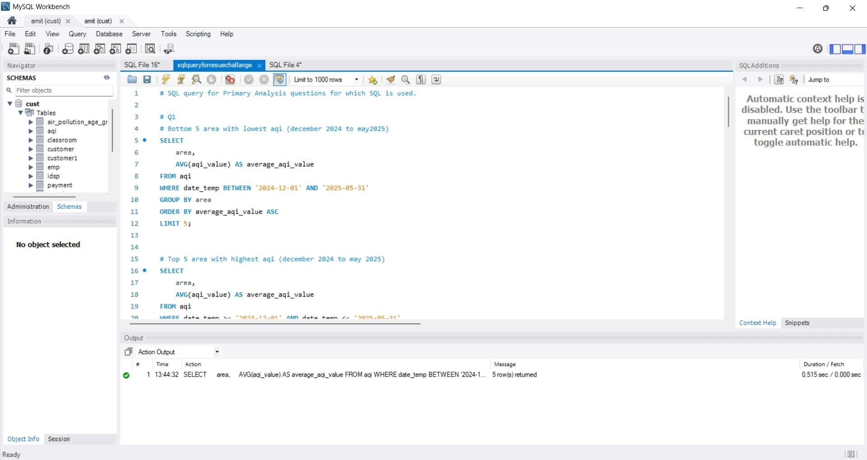

Slide 24
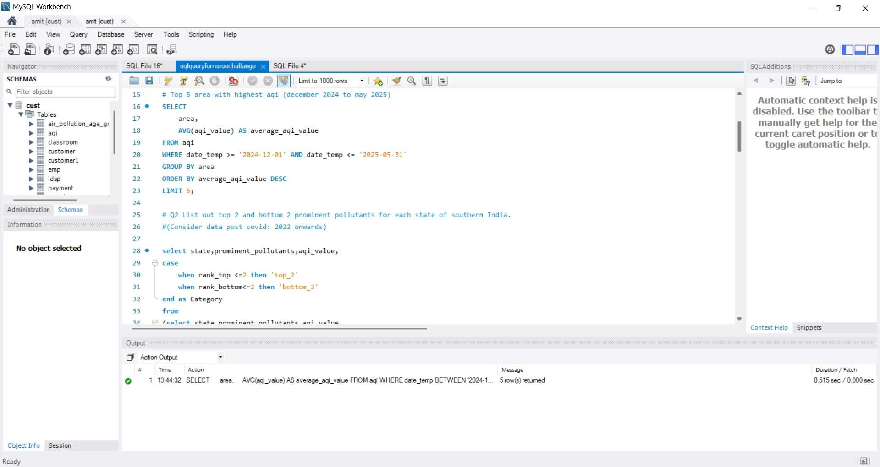

Slide 25
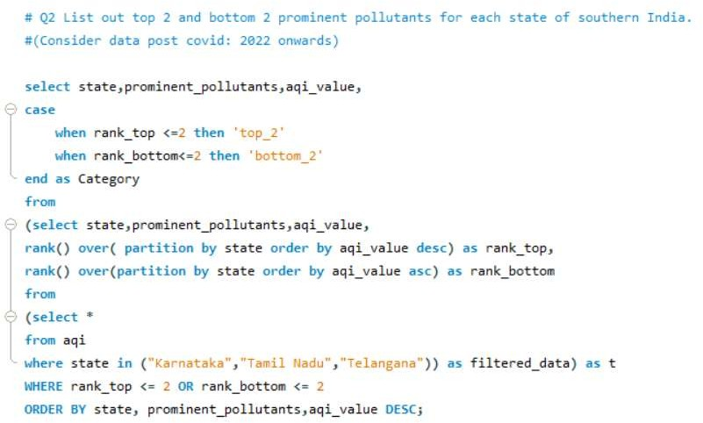

Slide 26
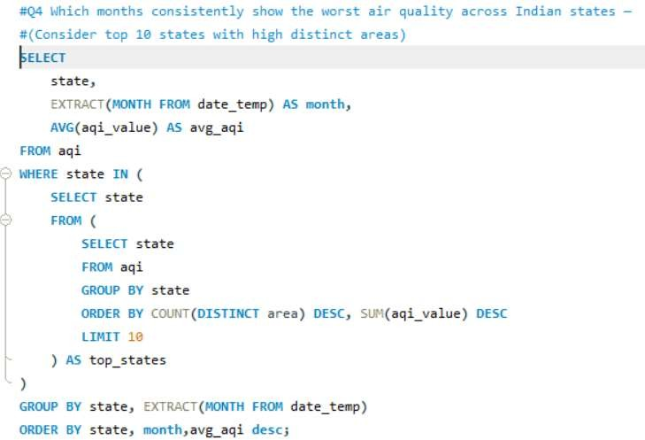

Slide 27
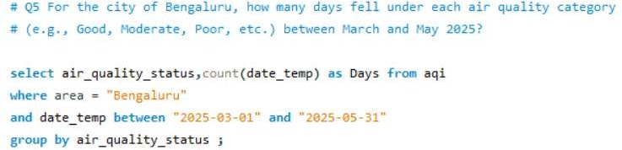

Slide 28
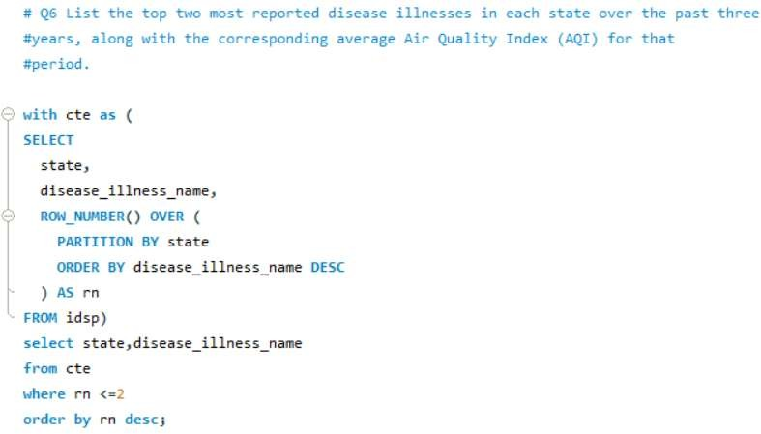

Slide 29
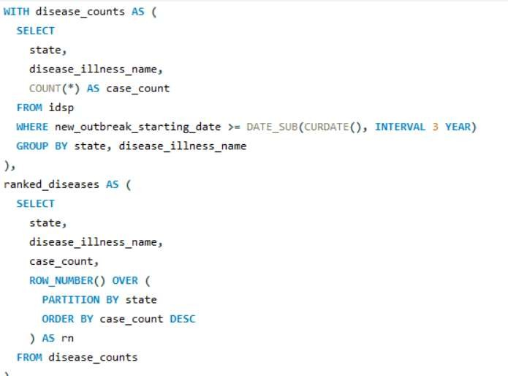
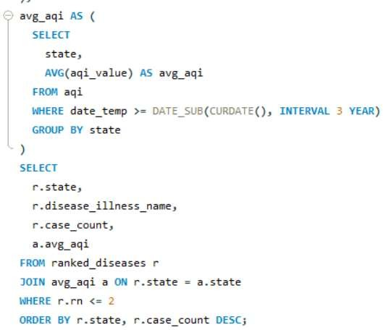

Slide 30
Thank You

